Slide 1


Slide 2
Chapter 7
Research Questions and Hypotheses

Slide 3
Introduction
Placing signposts for the reader
  Purpose statement
  Research questions or hypotheses
Research questions narrow the purpose statement
  Qualitative research questions
  Quantitative research questions and hypotheses
  Mixed methods research questions

Slide 4
Qualitative Research Questions
Qualitative researchers pose research questions
  Not objectives
  Not hypotheses
Two forms of qualitative research questions
  Central question
    Broad question that asks for exploration of the central phenomenon
  Subquestions
    Questions that narrow the focus of the study

Slide 5
Qualitative Research Questions
Ask 1–2 central research questions
  Broad and ask for exploration of the central phenomenon or concept
  Explore the general, complex factors about to the central phenomenon
  Present broad perspectives or meanings

Slide 6
Qualitative Research Questions
No more than 5–7 subquestions these will narrow the focus but leave open the questioning
Relate the central question to the strategy of inquiry
  Ethnography – culture sharing group, questions verify accuracy of data
  Critical ethnography – build on an existing literature
  Phenomenology – what participants experienced
  Grounded theory – generate a theory

Slide 7
Qualitative Research Questions
Begin with “what” or “how” to convey an open or emerging design
Focus on a single phenomenon or concept
Use exploratory verbs: report, describe, discover, generate, explore
Avoid directional words, like affect, influence, impact, determine, cause, relate

Slide 8
Qualitative Research Questions
Expect questions to evolve and change
Use open-ended questions without reference to the literature or theory (unless indicated)
Specify the participants and research site

Slide 9
Qualitative Research Questions
_________ (How or what?) is the _________ (“story for” for narrative research; “meaning of” the phenomenon for phenomenology; “theory that explains the process of” for grounded theory; “culture-sharing pattern” for ethnography; “issue” in the “case” for case study) of _________ (central phenomenon) for _________ (participants) at _________ (research site).

Slide 10
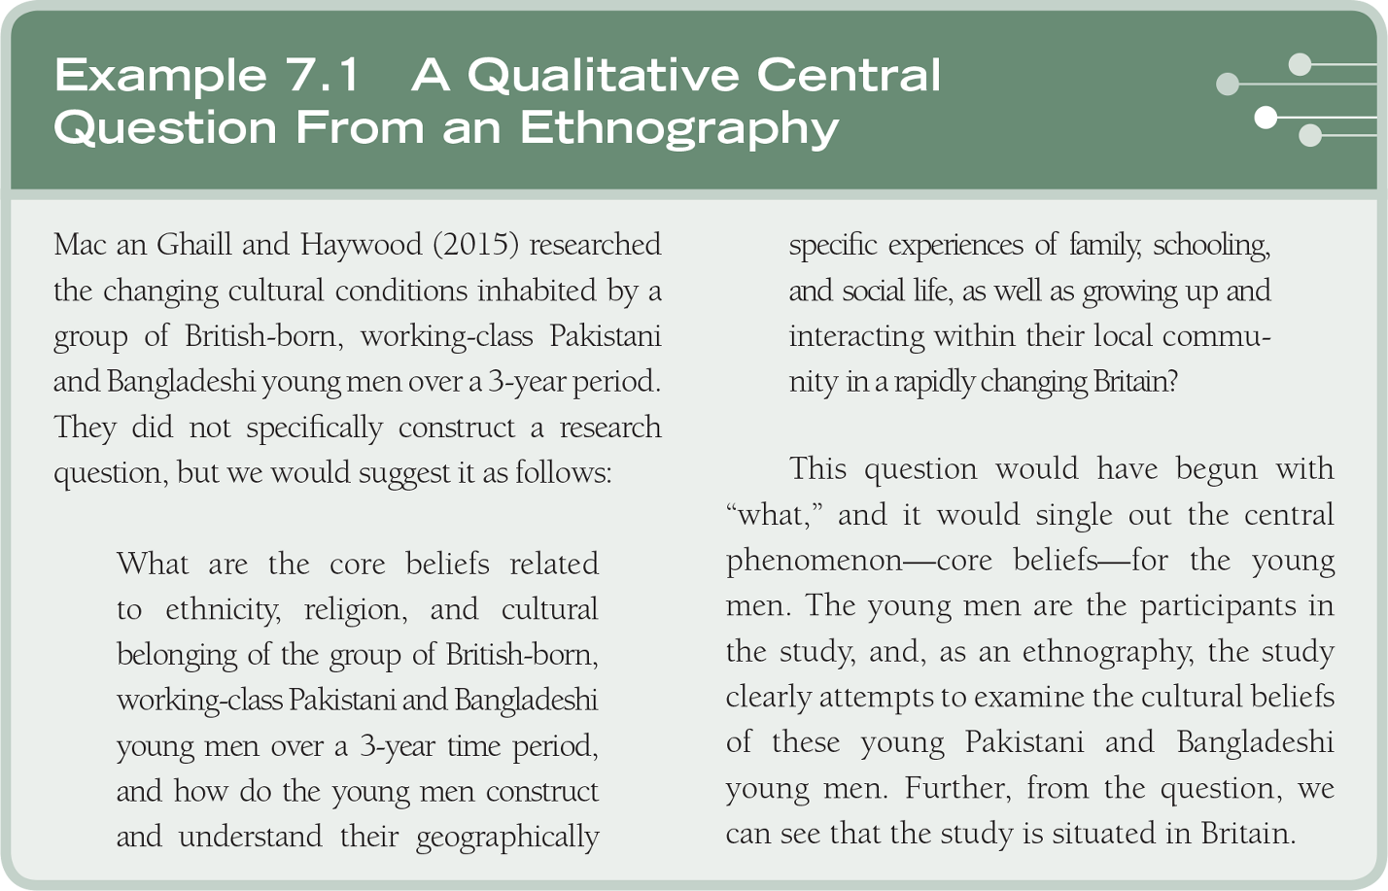
Qualitative Research Questions

Slide 11
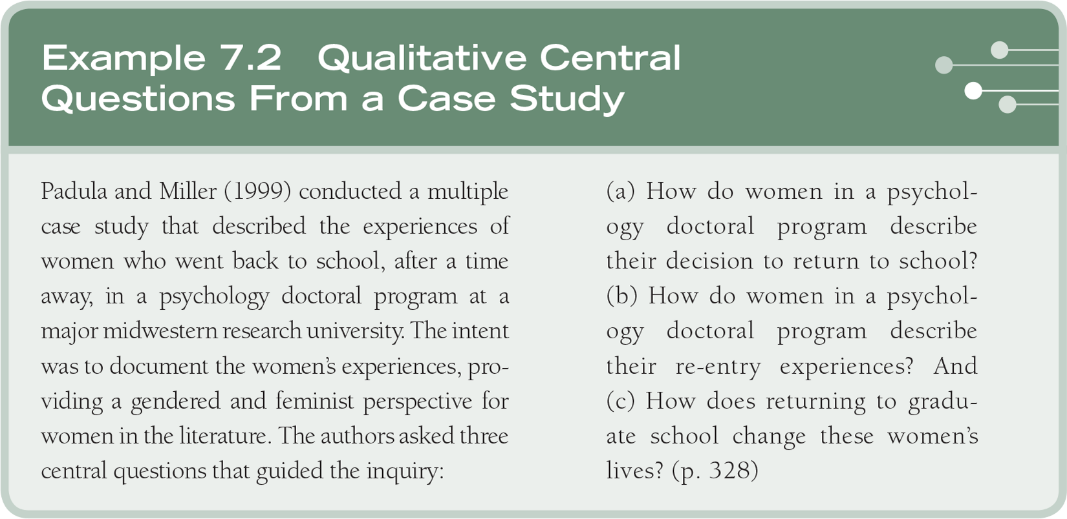
Qualitative Research Questions

Slide 12
Quantitative Research Questions and Hypotheses
Quantitative research questions
  About the relationships among variables that the investigator seeks to know
Quantitative hypotheses
  Predictions about the expected relationships among variables
  Estimates of population values based on data from a sample

Slide 13
Quantitative Research Questions and Hypotheses
Quantitative objectives
  Indicate a study's goals
  Often in proposals for funding, less common in health and social sciences

Slide 14
Quantitative Research Questions and Hypotheses
Quantitative research question describing outcomes:
What is the frequency and variation of scores on ____________ (name the variable) for ______________(participants) in the study?

Slide 15
Quantitative Research Questions and Hypotheses
Quantitative research question focused on examining the relationship among variables:
Does _________ (name the theory) explain the relationship between _________ (independent variable) and _________ (dependent variable), controlling for the effects of _________ (control variable)?

Slide 16
Quantitative Research Questions and Hypotheses
Quantitative null hypothesis:
There is no significant difference between _________ (the control and experimental groups on the independent variable) on _________ (dependent variable).

Slide 17
Quantitative Research Questions and Hypotheses
Three basic approaches
  Compare groups
  Relate variables
  Describe responses
Most rigorous form tests a theory
Measure the independent and dependent variables separately
Write questions or hypotheses
Null and alternative hypotheses

Slide 18
Quantitative Research Questions and Hypotheses
The use of variables in research questions or hypothesis if one wants to do
  An experiment or group comparisons
  A survey that correlates variables
  A descriptive study

Slide 19
Quantitative Research Questions and Hypotheses
Write research questions and hypothesis that logically follow from relationship among variables in a theory
Research questions or hypothesis may indicate cause and effect logic
Research questions and hypothesis should have no redundancies, do not write both

Slide 20
Quantitative Research Questions and Hypotheses
If writing hypotheses, use a consistent form
  Null hypotheses (predict no difference or no relationship)
  Alternative hypothesis or directional hypotheses (predict direction of difference or relationship)
  Nondirectional hypotheses (predict a difference or relationship, but not its direction)

Slide 21
Quantitative Research Questions and Hypotheses
Use nondemographic variables (mediating and moderating)
Use same word order in the questions or hypotheses to enable a reader to easily identify the major variables

Slide 22
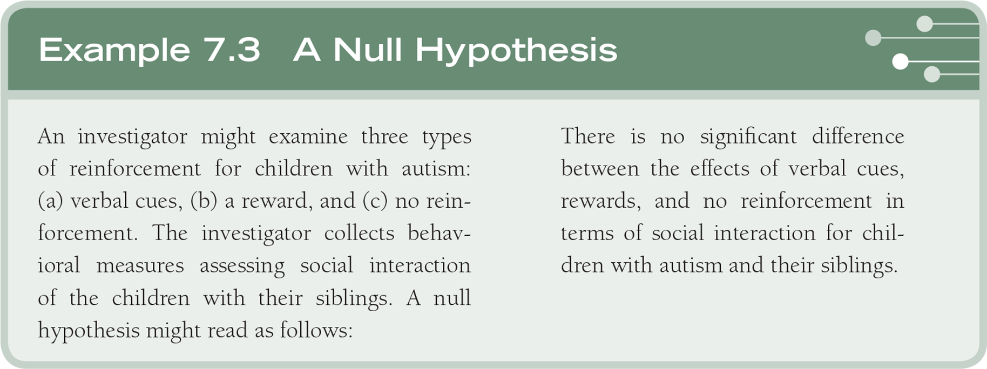
Quantitative Research Questions and Hypotheses

Slide 23
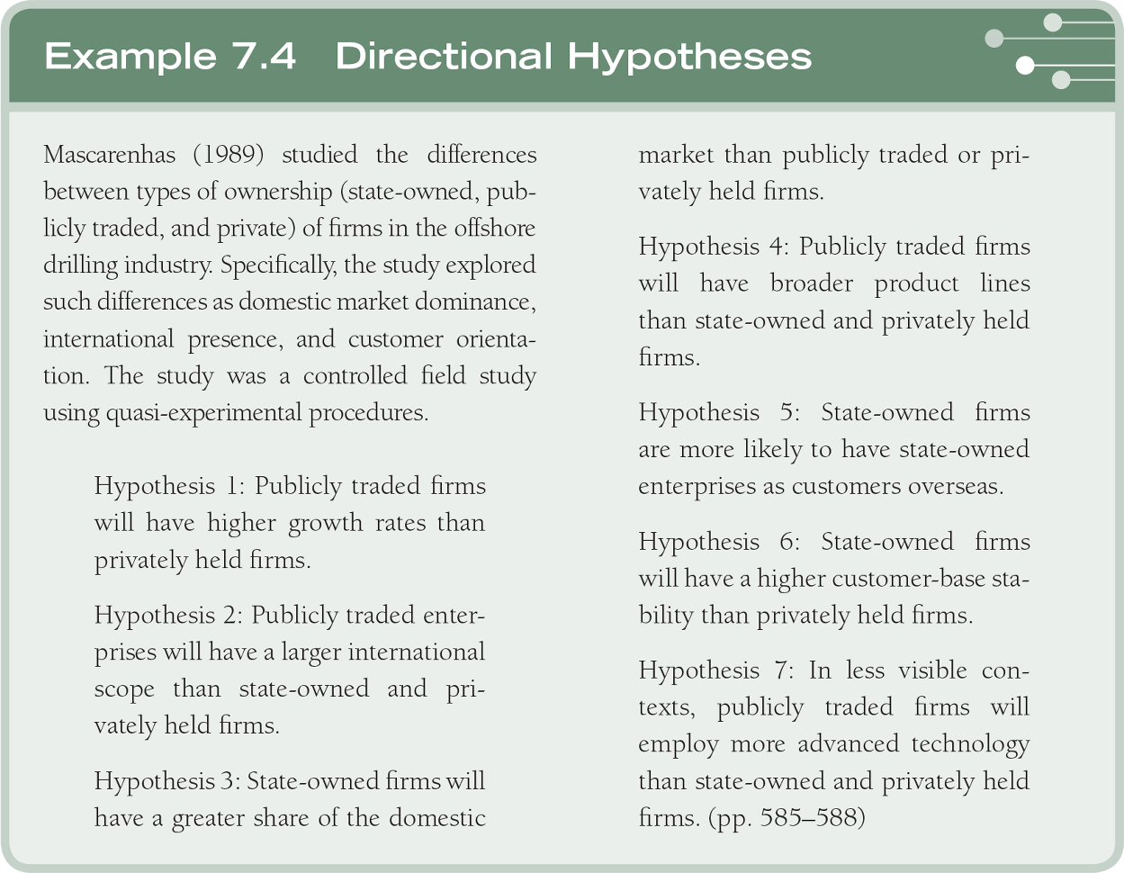
Quantitative Research Questions and Hypotheses

Slide 24
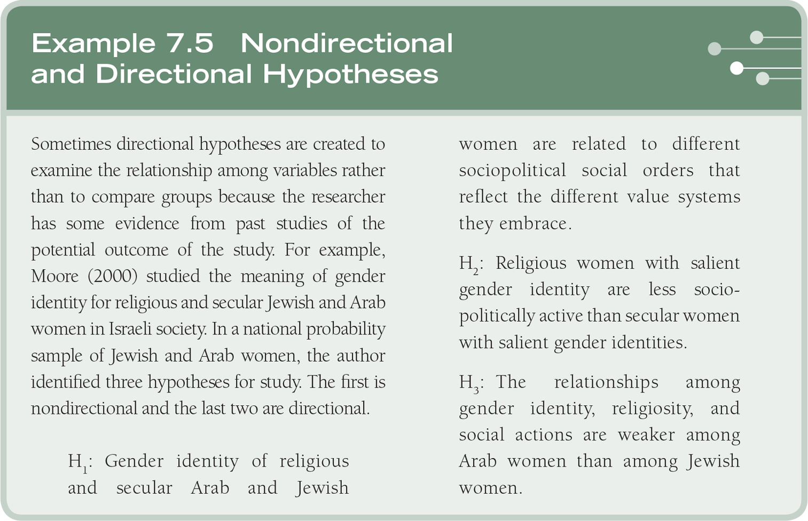
Quantitative Research Questions and Hypotheses

Slide 25
Quantitative Research Questions and Hypotheses
A model for descriptive questions and hypotheses:
Include both independent and dependent variables
Specify descriptive questions for each independent and dependent variable
Question for important mediating or moderating variables
May add inferential questions

Slide 26
Quantitative Research Questions and Hypotheses
A model for descriptive questions and hypotheses:
Descriptive questions | Inferential questions
How do the students rate on critical thinking skills? | How does critical thinking ability relate to student achievement?
What are the student’s achievement levels (or grades) in science classes? | How does critical thinking ability and prior grades influence student achievement?

Slide 27
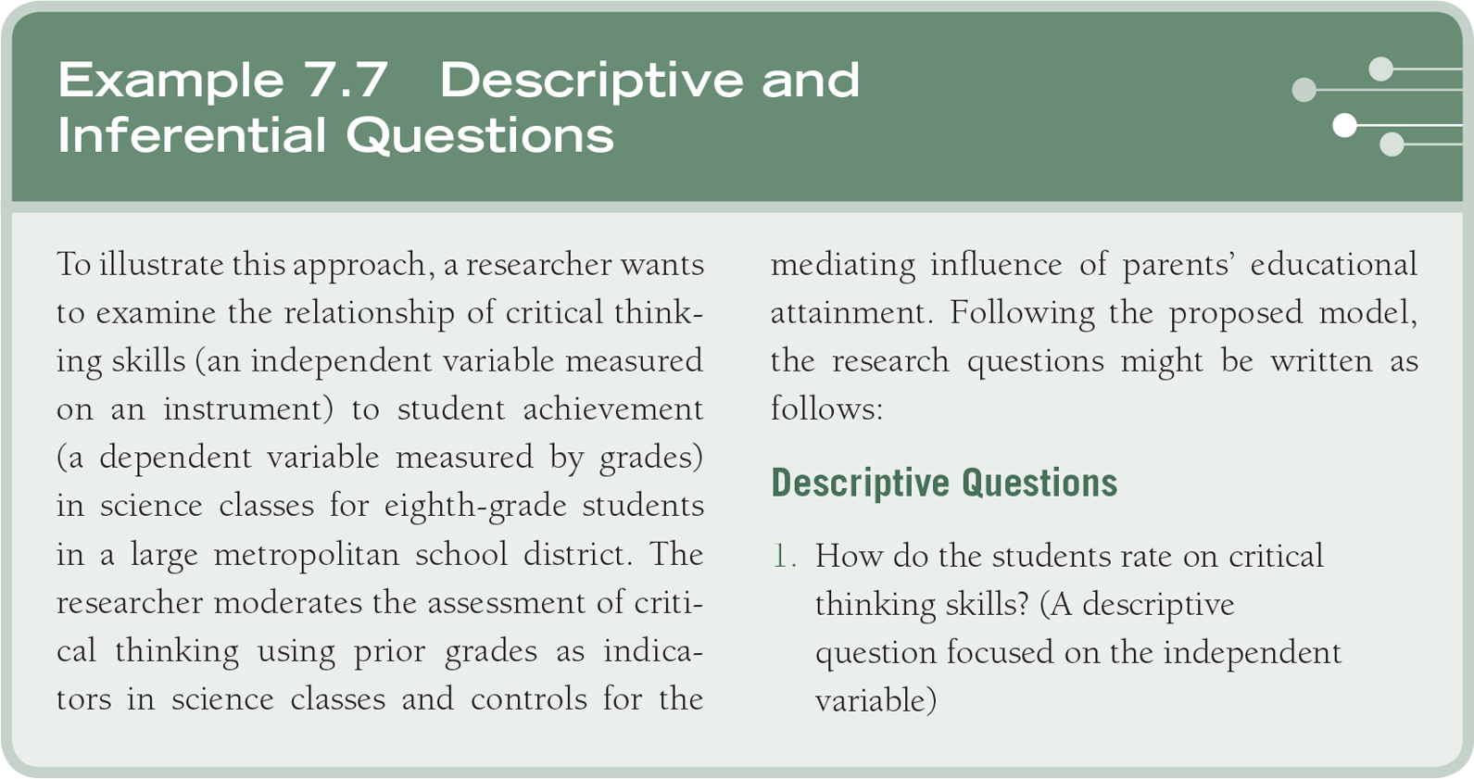
Quantitative Research Questions and Hypotheses

Slide 28
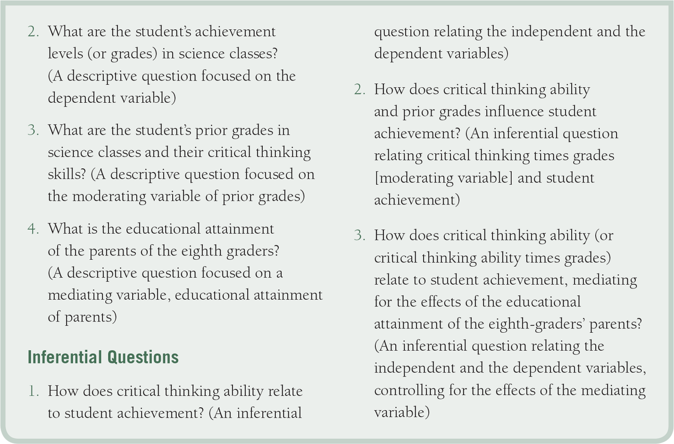
Quantitative Research Questions and Hypotheses

Slide 29
Mixed Methods Research Questions and Hypotheses
Include qualitative, quantitative (or hypotheses), and a mixed methods research question
Qualitative and quantitative questions focus the purpose
Mixed methods question conveys the importance of integrating
Use guidelines for qualitative and quantitative questions and hypotheses

Slide 30
Mixed Methods Research Questions and Hypotheses
Order questions to match the mixed methods design
  In a single-phase design, either first
  In a two-phase design, order to match the phases
  In three-phase, often mixed methods in the middle

Slide 31
Mixed Methods Research Questions and Hypotheses
A mixed methods research question directly addresses integration
Three forms
  Conveys the methods and procedures
  Conveys the content of the study
  Combines the methods and content in a hybrid question

Slide 32
Mixed Methods Research Questions and Hypotheses
Write separate questions or hypotheses followed by a mixed methods question
  This highlights the two approaches as well as their combined strength
  At the beginning or as they emerge in phases
  This places emphasis on the two approaches

Slide 33
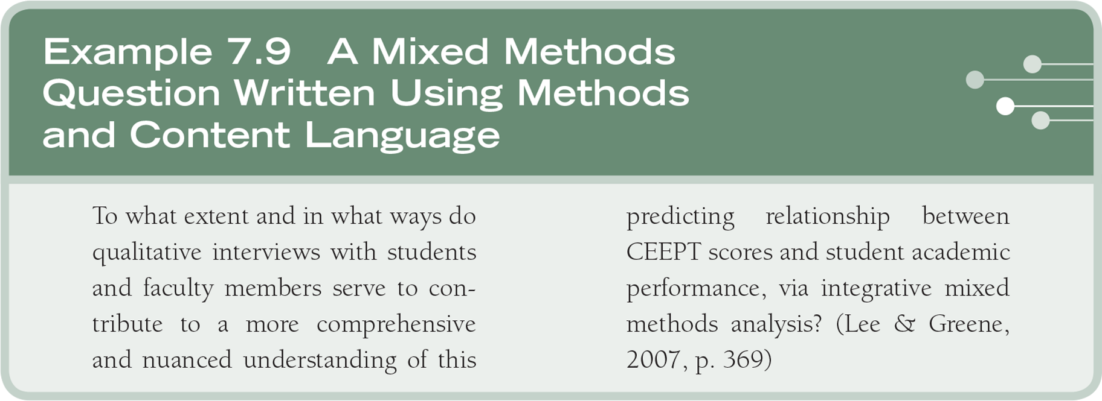
Mixed Methods Research Questions and Hypotheses

Slide 34
Summary
Research questions and hypotheses narrow the purpose statement and add signposts
Qualitative – central question and subquestions
Quantitative – describe, related, compare variables
Mixed methods – qualitative, quantitative, and mixed methods question

